Slide 1


Research priorities within Occupational Therapy

Slide 2
Why is it important to understand about research priorities?
It sets a clear research agenda for the profession
It ensures that time, effort and funding is centred on issues that matter the most to those who access and deliver Occupational Therapy services
It helps develop a healthy and proactive research culture
It enables research collaborations and centres to develop specialist knowledge
RCOT funding is focused on supporting research that addresses these priorities

Slide 3
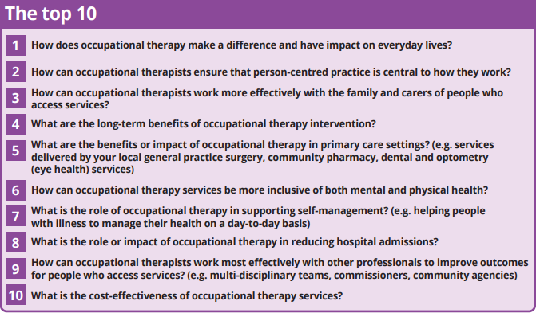
RCOT Research Priorities
(RCOT, 2019)

Slide 4
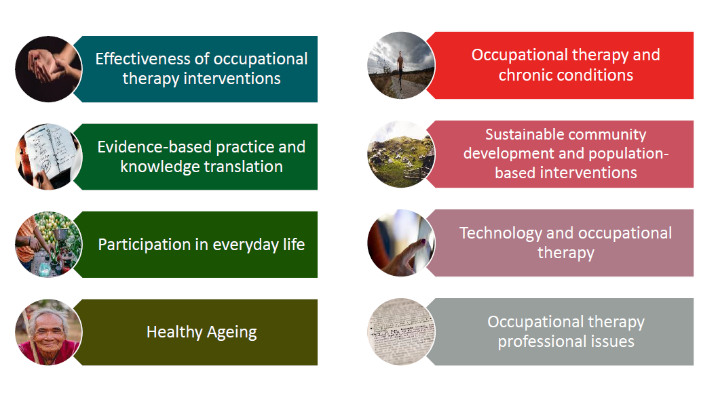
WFOT Research Priorities
(WFOT, 2016)

